Slide 1


GIS in Indian Power Utilities
April 2024

Slide 2

COVERAGE
Slide No.
 | Growth trends in Indian Power sector | 3
 | Introduction to GIS – Key Components & Working Principles | 4
 | Major Applications of GIS in Power Sector | 5
 | Types of GIS Technologies adopted by Power Sector Utilities | 6
 | Key Challenges Faced by DISCOMs and major solutions of GIS implementation | 7
 | State wise GIS Implementation in India | 8
 | GIS Implementation Case Studies – Adoption by Indian Power Utilities | 9
 | Case Studies – Select GIS Tenders | 13
 | Growth Outlook for GIS market | 16
 | Deloitte’s current capabilities in Power Sector Consultancy and opportunity to tap into GIS consultancy market | 17
 | Major Barriers to GIS implementation | 18
 | Key Takeaways | 19
 | Annexure
1
2
3
4
5
6
7
8
9
10
11
12

Slide 3

Growth trends in Indian Power sector
Indian Power Sector has witnessed significant growth in terms of capacity addition, demand etc; further growth envisaged
India has shown significant growth in terms of Demand and Energy requirement with same expected to grow at CAGR of ~6% and ~5.6% respectively
Transmission Line and Substation capacity have grown at a CAGR of ~4% and ~7.5% respectively from FY 2017 to FY 2024 (**as on Jan ’24), same is planned to increase significantly by FY 2027 as per CEA
Installed Capacity has grown in India at a CAGR of ~7.4% from FY 2010 to FY 2024 (*as on Feb ’24)
As per CEA report, total installed capacity is expected to double to about 817 GW by 2029-30
PSP
Source | Capacity (GW)
Coal | 267
Gas | 25
Hydro | 61
Nuclear | 19
Solar | 280
Wind | 140
Others | 25
Total | 817
1%
Coal
RES
2%
3%
Gas
Nuclear
Hydro
Power sector digitization has a crucial role for further sustainable growth, wherein one such technology that finds major application in the growth of the power sector is the implementation of Geographic Information System (GIS)

Slide 4
Introduction to GIS – Key Components & Working Principles
Computer-based system designed to capture, store, manipulate, analyze, manage, and present spatial or geographic data
What is GIS?
GIS is a powerful tool which can be defined as integrated sets of data, hardware, software and processes designed as a computer system for gathering, managing, mapping and analyzing spatial data.
Key Components
Working Principles
Hardware
GIS software operates on diverse hardware, ranging from centralized servers to desktop computers in standalone or networked setups.
Data
Geographic data and related tabular data can be collected in-house or purchased from a commercial data provider. A GIS will integrate spatial data with other data resources and can even use a DBMS, used by most organizations to organize and maintain their data, to manage spatial data.
1. Geographic References
Geographic information includes explicit references like latitude and longitude or national grid coordinates, as well as implicit references such as addresses, postal codes, census tract names, forest stand identifiers, or road names.
Geocoding, an automated process, transforms implicit references (e.g., addresses) into explicit geographic coordinates, enabling location-based analysis.
2. Vector and Raster Models:
Software
GIS software provides functions for storing, analyzing, and displaying geographic information, including tools for data input and manipulation, a database management system (DBMS), support for geographic query, analysis, and visualization, all accessible through a user-friendly graphical interface (GUI).
Vector Models
In the vector model, points, lines, and polygons are encoded and stored as x,y coordinates.
Point features, like bore holes, are represented by single x,y coordinates.
Linear features, such as roads and rivers, are stored as a sequence of point coordinates.
Polygonal features, like sales territories and river catchments, are stored as closed loops of coordinates.
While excellent for discrete features, the vector model is less effective for continuously varying features
Raster Models
The raster model has evolved to model such continuous features. A raster image comprises a collection of grid cells rather like a scanned map or picture
Methods
A successful GIS operates according to a well-designed plan and business rules, which are the models and operating practices unique to each organization.
Both the vector and raster models for storing geographic data have unique advantages and disadvantages.
Modern GISs are able to handle both models.

Slide 5
Major Applications of GIS in Power Sector
GIS data is used by Utilities for Site Selection, Energy Audit, Load Management, Network Planning and analysis, inter alia.
Spatial data analysis
Power-related analytics with geospatial components include load flow analysis, network fault tracing, condition-based maintenance, real-time disaster situational awareness, Volt/VAR analysis, and vegetation management.
Network Mapping & Optimization
The electrical network and routes undergo detailed surveying with high precision DGPS* instruments, which are then digitized and mapped onto a base map using GIS software.
Key Features of GIS for Power Utilities
* Differential Global Positioning System
Site Selection
GIS assists in selecting suitable areas for infrastructure development, such as identifying optimal locations for new substations, power plants, or renewable energy installations, by analyzing spatial data on terrain, land use, and environmental factors.
Customer Information Management System
GIS in the power sector optimizes service delivery by integrating consumer locations with network assets, while also enabling efficient field crew tracking and geo-fencing for operational and maintenance activities. Staff and assets are tagged to geo-locations, streamlining commercial operations and enhancing vigilance efforts.
The use of GIS can help various other processes like SCADA, Distribution Management System, Outage Management System, Network Planning, Energy Auditing, Field Force Automation, Asset Management, Customer Relationship Management, vehicle tracking etc. to derive various business benefits

Slide 6
Types of GIS Technologies adopted by Power Sector Utilities
Major types of GIS technologies that can be adopted are provided based on multiple parameters
ESRI ArcGIS
Customized GIS Solutions
ESRI's ArcGIS platform is widely used by many DISCOMs across India due to its comprehensive set of tools for spatial analysis, asset management, network planning, and customer service. DISCOMs may use ArcGIS Desktop, ArcGIS Online, or ArcGIS Server depending on their specific needs and IT infrastructure
Larger DISCOMs or those with specific requirements may develop or commission customized GIS solutions tailored to their needs. These solutions may involve the integration of various technologies and data sources to support activities such as network optimization, outage management, and consumer engagement
Open Source GIS Solutions
Cloud-Based GIS Platforms
Some DISCOMs, particularly smaller utilities or those with budget constraints, may opt for open-source GIS solutions such as QGIS (Quantum GIS) or GeoServer. These platforms offer cost-effective alternatives with robust functionality for mapping and spatial analysis.
With the growing trend towards cloud computing, some DISCOMs may leverage cloud-based GIS platforms such as ArcGIS Online or Google Maps Platform. These platforms offer scalability, flexibility, and accessibility, allowing DISCOMs to deploy GIS applications without significant upfront investments in hardware or software
Vendor-Specific GIS Solutions
Mobile GIS Applications
Certain DISCOMs may choose GIS technologies provided by specific vendors other than ESRI, such as MapInfo from Pitney Bowes or Bentley Systems' GIS solutions. These platforms offer similar functionalities to ArcGIS and may be preferred based on factors such as vendor relationships, licensing agreements, or compatibility with existing systems
Many DISCOMs utilize mobile GIS applications to empower field personnel with access to GIS data and tools while on the go. These applications enable tasks such as asset inspection, maintenance, and outage response to be performed efficiently in the field

Slide 7
Key Challenges Faced by DISCOMs and major solutions of GIS implementation
Through the implementation of GIS, major challenges faced by Utilities as mentioned below are addressed
Power Distribution Company deals with HT & LT electrical networks and related consumers spread over wide geographical area to ensure supply availability
Challenges faced by Utilities
In past, Discoms have been using conventional Physical Area Maps for proper O&M and management of the system
However, over the years, DISCOMs have accumulated losses due to high T&D and Commercial losses. This has been mainly attributed to Non-adoption of IT in network management, operations and energy accounting
To address the issue, GOI intervened and took initiative under R-APDRP for establishment of IT system with extensive use of GIS
With respect to above, GIS implementation in power utilities finds following use cases:
Collection of baseline data & IT enabling of utility’s business procedure
IT based energy accounting/auditing
IT based distribution network analysis & corrective measures for performance optimization
Establishment of SCADA/DMS system to improve Power supply reliability in major towns

Slide 8
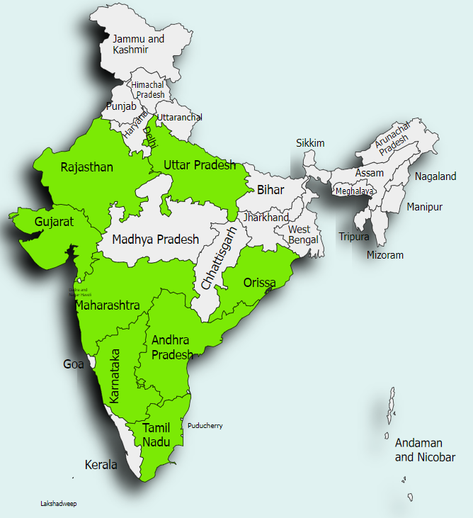

State wise GIS Implementation in India
GIS has already been implemented in major states
Jaipur
Uttar Pradesh
Jaipur Vidyut Vitran Nigam Limited (JVVNL) and other DISCOMs in Rajasthan have been involved in GIS projects
Uttar Pradesh Power Corporation Limited (UPPCL) and its DISCOMs have been exploring GIS solutions for distribution network management
Delhi
Gujarat
BSES Yamuna Power Limited (BYPL), BSES Rajdhani Power Limited (BRPL), and Tata Power Delhi Distribution Limited (Tata Power-DDL) are some of the DISCOMs in Delhi that have implemented GIS technology
Gujarat Urja Vikas Nigam Limited (GUVNL) and its subsidiary distribution companies have also been active in GIS implementation initiatives
Maharashtra
Odisha
Maharashtra State Electricity Distribution Company Limited (MSEDCL) has been a frontrunner in implementing GIS technology for its distribution network
Odisha Power Transmission Corporation Limited (OPTCL) and its DISCOMs have shown interest in GIS for improving network management
Karnataka
Telangana
Bangalore Electricity Supply Company (BESCOM) and other DISCOMs in Karnataka have applied GIS for infrastructure mapping and asset management
Telangana State Southern Power Distribution Company Limited (TSSPDCL) and Telangana State Northern Power Distribution Company Limited (TSNPDCL) have shown interest in GIS for distribution network management
Tamil Nadu
Andhra Pradesh
Tamil Nadu Generation and Distribution Corporation Limited (TANGEDCO) has been exploring GIS solutions for its distribution network
Andhra Pradesh Eastern Power Distribution Company Limited (APEPDCL) and Andhra Pradesh Southern Power Distribution Company Limited (APSPDCL) have been involved in GIS projects.

Slide 9
GIS Implementation Case Studies – Dakshin Haryana Bijli Vitran Nigam Ltd.
Dakshin Haryana Bijli Vitran Nigam (DHBVN) has implemented GIS as part of RAPDRP Scheme
Background
The Dakshin Haryana Bijli Vitran Nigam (DHBVN), owned by the State Government of Haryana, is responsible for distributing power in South Haryana. With operations in 11 circles, DHBVN caters to a total consumer base of around 3.8 million.
Before 2015, DHBVN followed a manual system of data collection for its entire distribution network. The department was neither able to collate a central database of the network and customer details, nor monitor the system. The field officers had to be contacted to identify the exact number of transformers or poles in a particular location or the number of feeders in the field.
Since there was no centralized system and most of the processes were manual, the available data was obsolete and posed a high margin for errors, ultimately increasing AT&C losses.
Implementation of GIS by DHBVN
3. Benefits Realized
4. Financial Impact
Cost and time savings with higher visibility and automatic updates.
Improved customer satisfaction with reduced response time for new connections and timely error resolution
Significant investment (₹1.2 billion) in IT system.
Yearly profits achieved through AT&C loss reduction.
1. Implementation
6. Next Steps
Adopted GIS under R-APDRP initiative.*
Utilized Differential Global Positioning System (DGPS) and Esri's ArcGIS platform.
Integration with field operations via ArcGIS Collector app.
Expansion of GIS usage and implementation of SCADA system in key areas.
2. Functionalities
5. Operational Efficiency
Centralized data access and tracking.
Network tracing, reporting, and single-line diagram creation.
Integration with 3rd party systems for Load Flow Analysis.
Enhanced visibility for staff, reduced field visits, and timely error resolution.
*Scope and challenges of GIS implementation in RAPDRP is provided in Annexure
Notes:
CYMDIST - Distribution system analysis package

Slide 10



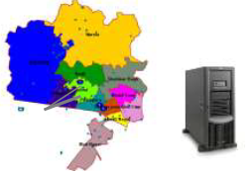




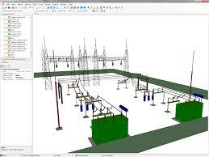
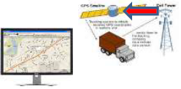

GIS Implementation Case Studies – Tata Power Delhi Distribution Limited (1/2)
Detailed implementation outlay of GIS for Tata Power Delhi Distribution Ltd (TPDDL) is provided below
Use Cases of GIS at TPDDL
GIS Outlay as adopted by TPDDL
SAP-ISU
CYMDIST
Feeder to DT and DT to Consumer hierarchy from GIS
Energy Auditing
Network Planning
SCADA
End User
System/Process Integration
SAP-ISU
Search Assets
Outage Management System (OMS)
Connection Management
DMS
Operations Management
Energy Audit
View Asset Location
Subscriber Indexing
Geographic Information System (GIS) implemented by TPDDL
OMS
Connection Management
View Asset Connectivity
Digitization
Design manager
Fault Management
Planned Interruptions Management
Asset Management
Field Automation
SAP-PM
Get Network Reports
Network Planning
Job Order Management
Notes:
CYMDIST - Distribution system analysis package

Slide 11
GIS Implementation Case Studies – Tata Power Delhi Distribution Limited (2/2)
GIS-based models of TPDDL wherein Asset, Operation, Connection and Network Management is carried out
GIS Input Output for Asset Management
GIS Input Output for Operation Management
Input
Design/Notification for -
Processing in GIS
Output
Integration with SAP
Network changes (ST/HT)
New Installation /Augmentation
Movement
Retirement
Scheme clearance requests
Geo-referenced mapping of Assets
Single Line Diagram Update
Tagging of Scheme
Asset Equalization with GIS-SAP-FAR
Clearance for Technical completion of scheme
Integration with OMS -
Planned Outage
Complaint Management
Integration with DMS-
Geo-tagged SLD
Input
Processing in GIS
Output
Geo-referenced mapping of Assets and network
Delivery of updated GIS for operation.
Consumer linkage with Pole No.
LT network intimation
OMS notification
Network details through notification
Mapping of consumers.
Data Merging and Creation of Circuit id
GIS Input Output for Connection Management
GIS Input Output for Network Management
Input
Processing in GIS
Output
Pole No. from Meter Management Group
Consumer Mapping in GIS
Integration with SAP -
Connectivity of consumer with -
LT Feeder
Transformer
HT Feeder
ST Feeder
Energy auditing
Revenue Protection
Integration with OMS -
List of affected consumers
Location of affected consumers
Crew management
Input
Processing in GIS
Output
Network changes due to -
Geo-referenced digitization of -
Integration with Network Planning tool (CYMDIST)
Load Balancing
Network Extension
Network Augmentation
New Electrification
Network Shifting
Revised network route
Revised network connectivity
GIS based Network Planning
Notes:
CYMDIST - Distribution system analysis package

Slide 12
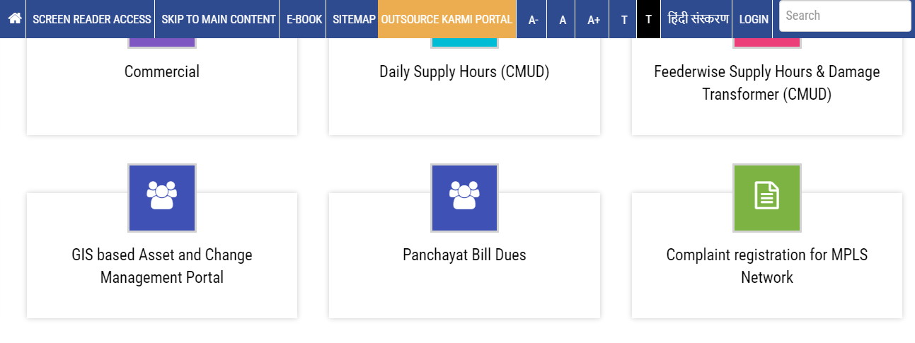
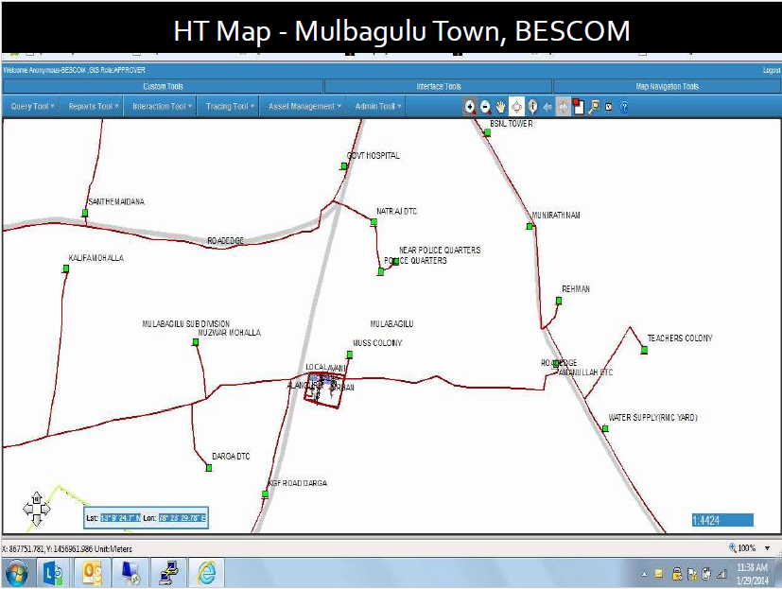
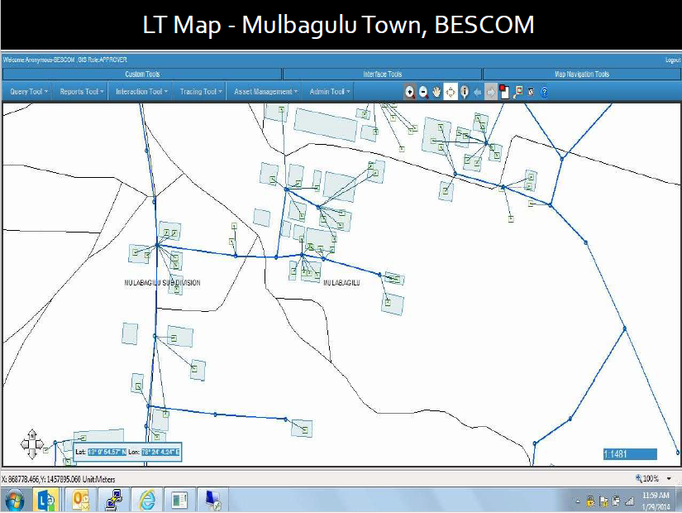
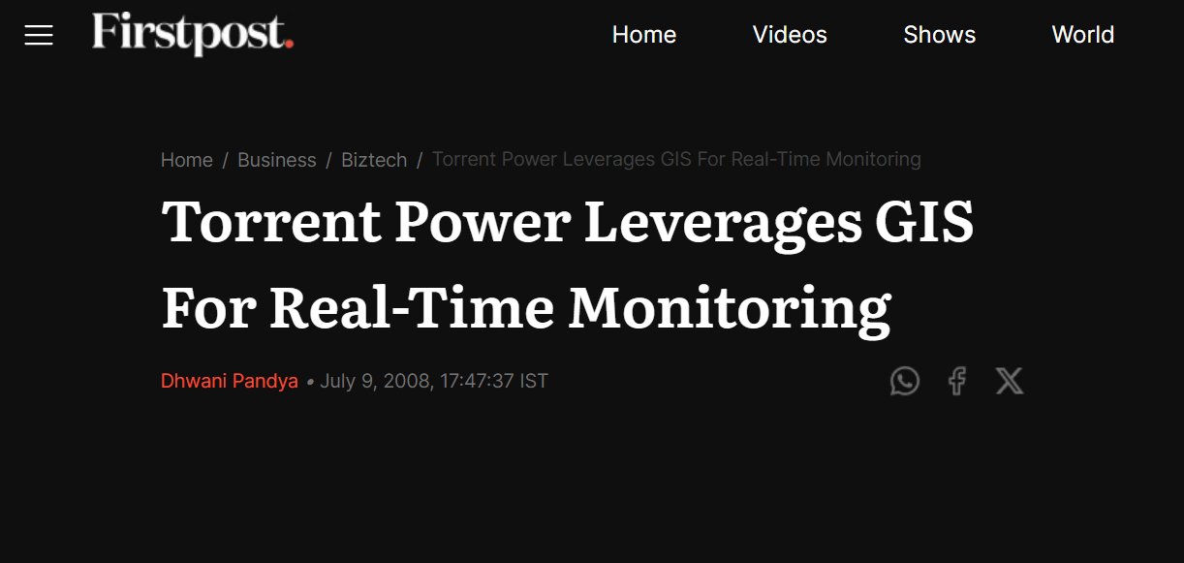
GIS Implementation Case Studies – Adoption by Indian Power Utilities
Snapshots of other Indian power utilities adopting GIS
GIS application tool in UPPCL (UP DISCOM) Intranet Facility
Illustrative GIS Maps used by BESCOM (Karnataka DISCOM)
News snapshot of Torrent Power implementing GIS
Notes:
CYMDIST - Distribution system analysis package

Slide 13
Case Study – Tripura GIS Consultancy Tender
Most recent GIS tender floated by Tripura power utility in January 2024 for ADB funded project
Background
The Asian Development Bank (ADB) is assisting the Government of Tripura and its executing agencies, Tripura State Electricity Corporation Limited (TSECL) and Tripura Power Generation Limited (TPGL), with financial and technical support.
The proposed consulting assignment aims to develop a master plan for electricity distribution network development, enhance technical systems and resources for TSECL's planning and operations, and conduct an organizational review for effective management and operation of functions.
Scope of Work - Overview
Eligibility Criteria/ Criteria for Marks
Survey of TSECL Distribution Network and TPGL Generation Assets (Including Mapping)
Firm’s experience in similar projects
Firm’s experience in similar geographic areas
Meeting of minimum criteria of each Key experts in terms of education and work experience*
1
Develop an Asset Database using suitable asset data management software recommended by the Consultant and acceptable to TSECL.
2
Preparation of Distribution Network Development Roadmap
Required Team of Experts
3
Team Leader
Project Manager
Distribution Systems Planning Expert
Knowledge Transfer, Training and Capacity Building
4
Distribution System Engineer
Gas Generation Expert
Hydro Generation Expert
Setting up of Distribution Construction Standards
5
GIS/Mapping Expert
HR Expert
Distribution Commercial Process/ Metering & Billing Exp
Organizational/Institutional Review and Capacity Building Roadmap of TSECL
6
IT Expert
International Experts
National Experts
*Details of educational and professional experience required for each expert is provided in Annexure

Slide 14
Case Study – DHBVN GIS Rollout and Asset Mapping Tender
Tender floated by DHBVN for implementation of GIS in Haryana under RAPDRP scheme
Background
Dakshin Haryana Bijli Vitran Nigam (DHBVN) invited the bids on behalf of both DISCOMs viz. Dakshin Haryana BijliVitran Nigam (DHBVN) and Uttar Haryana BijliVitran Nigam (UHBVN).
Both the Discoms of Haryana, have a common integrated IT solution in the entire state.
The selected bidder would be be responsible for detailed design and engineering of overall GIS system, subsystems, elements, system facilities, equipments, services, including GIS systems application software etc.
Scope of Work - Overview
Eligibility Criteria/ Criteria for Marks
To update GIS, Asset Survey in the data base of existing GIS system developed under R-APDRP Part-A (IT) project.
The bidder should have executed at least one similar project (Involving establishment of GIS based system with customization & configuration of GIS application, mapping of assets and digitization services etc) in power utility during the last five financial years.
A minimum of 10 CVs having five-year experience in GIS domain (GIS based system with customization & configuration of GIS application, mapping of assets, data digitization)
GPS based field survey & asset mapping activities for EHT/HT Electrical Network in the IPDS towns & remaining Non R-APDRP areas of DHBVN & UHBVN,
digitization of the surveyed data,
building up of the GIS database, publication of the EHT/HT Electrical Network details on the existing GIS platform,
successful rollout of the GIS application along with duly mapped assets and consumers tagged on DT/Fs
*Consumer Indexing not in the scope of the agency. However, DT/F wise consumer info shall be provided by Utility)
5 years support services to DHBVN & UHBVN for the back office system of GIS & field manpower required for GIS Delta Updation on continuous basis

Slide 15
Case Study – Tender for Consultancy Services for Formulation Of GIS based Master Plan For AMRUT cities in Chhattisgarh State
GIS tender for infrastructure sector with respect to Urban planning in Chhatisgarh
Background
Government of India launched Atal Mission for Rejuvenation and Urban Transformation (AMRUT) in 2015 as Centrally Sponsored Scheme.
Formulation of GIS-based Master/Development Plans for 500 AMRUT Cities was one of the important reforms under AMRUT, which had been approved as a 100% centrally funded subscheme with budget outlay of Rs. 515.00 crores
The major objectives of the sub-scheme are:
To develop common digital geo-referenced base maps and land use maps using Geographical Information System (GIS) and
Master Plan Formulation for 500 cities that are selected as AMRUT Cities.
Scope of Work - Overview
Eligibility Criteria/ Criteria for Marks
Preparation of master plan including attention to aspects like Spatial growth of the town & direction, incorporation of new areas, all vacant lands under government ownership (non-built), all forest lands, Places of tourist and heritage importance both natural and manmade including natural areas, fairs and festivals, etc.
Overall experience in similar assignments (5 for max marks)
Consultancy project experience (5 for max marks)
Experience in plan formulation using GIS database (5 for maximum marks)
Spatial attribute collection and vetting of Base Map
Required Team of Experts
Urban Database Creation
Team Leader/ Urban Planner
GIS Expert
Transport Planner
Support by Consultant after approval of Draft Master Plan
Socio-Economic Expert

Slide 16
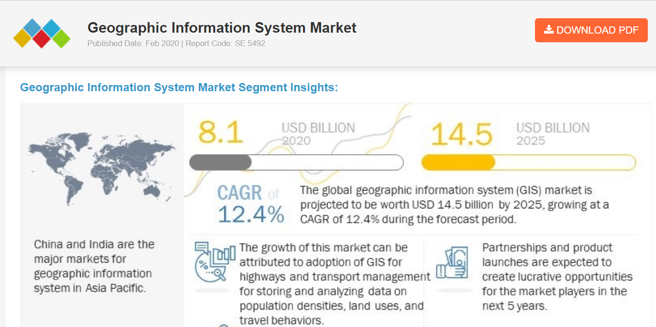
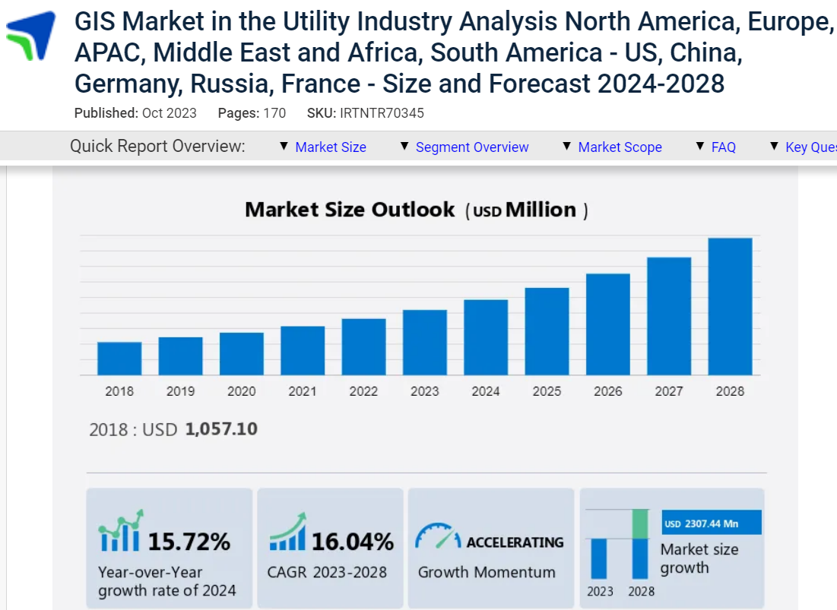

Growth Outlook for GIS market
Market Research reports indicate significant growth of GIS market globally with countries like India and China leading the pack
Multiple Market research reports indicate that global GIS market is set to increase at an impressive CAGR of ~12-16%
With increase in power utilities adopting GIS as well, indicative growth may be expected in Indian power sector as well

Slide 17
Deloitte’s current capabilities in Power Sector Consultancy and opportunity to tap into GIS consultancy market
INPUTS REQUIRED

Slide 18
Major Barriers to GIS implementation
GIS implementation typically is laced with some challenges as outlined below
01
Data Standardization and Acquisition Challenges
Ensuring uniformity and quality in data from diverse sources within the power sector poses a significant hurdle. Acquiring accurate and up-to-date data while adhering to standardized formats is crucial for effective GIS implementation.
Complexity of Enterprise GIS Technologies
02
03
Skill Gap in GIS Expertise
The scarcity of professionals with adequate GIS expertise within the power sector can impede successful implementation. Training and developing skilled personnel are essential to effectively utilize GIS tools and technologies.
The deployment of Enterprise GIS within the power sector involves the integration of complex technologies, such as spatial databases, web mapping services, and real-time monitoring systems.
Comprehensive System Design Challenges
04
05
User and Process Mapping Complexity
Identifying and defining the diverse categories of users, their workflows, and the specific data requirements across different departments in the power sector is a complex undertaking.
Designing an Enterprise GIS system for the power sector requires meticulous planning to address the needs of various user groups, data types, and operational processes.
*Challenges of PSU power utilities in GIS solution implementation are provided in Annexure

Slide 19
Key Takeaways
Growth trend in both Indian Power Sector as well as global GIS market (with countries like India and China leading in the Asia Pacific region as per market research reports)
Increasing trend of Indian Power Utilities adopting GIS
Opportunity for Deloitte to tap into growing GIS market especially with respect to the Power sector
Significant on-ground personnel with relevant experience would likely be required
Relook at Deloitte’s current capabilities to carry out such projects and addressing gaps if any finds some merit

Slide 20
Annexures

Slide 21
Scope and challenges of GIS implementation under RAPDRP scheme
Scope of GIS in RAPDRP
Challenges
Mapping of all assets (66kV/33KV/11KV, LT) including HT & LT network entities upto poles & major landmarks.
Collection of consumers attributes through door-to-door survey and indexing with network assets.
Overlaying of digitized electrical network & consumers on the base map with area features and attributes using SW for GIS application.
Integration of GIS system with other IT applications
Delay in Availability of Imageries.
Non-availability of skilled manpower with GIS agencies for field survey.
Capture of too many attributes,
Huge errors in linking of assets, between assets & consumers, their attributes collection, etc.
Slow progress in survey data validation by utilities due to manpower shortage, lack of coordination.
Slow opening of GIS basemap on system.
Delay in updation of incremental changes leading to inaccurate Energy Accounting.
Lack of expertise with utilities for Post Go Live activities.
Back
Notes:
CYMDIST - Distribution system analysis package

Slide 22
Challenges of PSU power utilities in GIS solution implementation (as observed)
Shortage of technical manpower for GIS implementation. GIS for utilities is not mere mapping, it should replicate the network topology and connection logic. PSU utilities don’t have tech manpower, nor even understanding of the technology specifications for this.
Above brings in complete dependence on external vendors. However, most of the time due to fund paucity external vendor contracts are terminated before tangible outcome is achieved.
Over dependence on vendor and non-availability of internal monitoring capability by utility, many a time led to vendor service quality issues are unrecognized.
Utilities don’t maintain records, as a result entire work has to be carried out through field survey. This in turn brings dependencies on linemen who have the knowledge at individual level but in turn are not too keen to engage or cooperate for lack of personal interest.
Due to absence of clear understanding of the use of GIS use cases, decisions are delayed at utility side.
Most of the SIs implemented ArcFM solution or GESmall world with additional custom development during RAPRDP. Maintenance of the solution is a costly affair and most utilities stopped AMC
As utility network constantly evolves, in the absence of continual update legacy data become unreliable or unusable. So, for starting fresh the old data also need complete refresh.
Due to non-availability of vendor support most utilities are not able to download data created or migrate to low cost solutions
Only few utilities developed alternate GIS approach and are able to leverage its benefit. However, FM solutions are the ultimate requirement
Back
Notes:
CYMDIST - Distribution system analysis package

Slide 23
Criteria for Team of Experts in Tripura Tender (1/4)
Detailed Educational and Professional Experience Required for Tender
Position / Expertise | Experience and Qualifications | Responsibilities / Roles
International Experts
Project Manager / Team Leader (International) 8 Person-months | Graduate in Engineering (Power/Electrical/Electronics) and Postgraduate in Management or Engineering (Electrical/ Electronics) At least 15 years of experience in providing consultancy on power distribution system improvement, loss reduction, distribution system planning Led similar large consultancy projects with power distribution companies | Lead role in management of consulting team. Overall project planning and discussions with senior management of client Overall review of the tasks and progress of the project Co-ordination with the consultant team and the client for smooth implementation of the assignment Plan for asset survey and mapping and overall management of the survey team Developing the plan for training and capacity building of staff and knowledge transfer to ensure institutionalization of the system study function in TSECL Provide technical advice to carry out all tasks. Coordination of project activities with TSECL & ADB. Ensure timely completion and delivery of all outputs
Distribution Systems Planning Expert (International) 9 Person-months | Graduate in Engineering (Power/Electrical/Electronics) and preferably Post Graduate in Engineering (Power/Electrical/Electronics) At least 10 years of experience in planning of distribution system and distribution system operations Should have experience of providing consultancy on distribution loss reduction and system planning | Providing technical support for asset study Lead role in carrying out roadmap study for carrying out all tasks in tasks under para. 8. Training and capacity building Support for development of distribution construction standards
Back
Notes:
CYMDIST - Distribution system analysis package

Slide 24
Criteria for Team of Experts in Tripura Tender (2/4)
Detailed Educational and Professional Experience Required for Tender
Position / Expertise | Experience and Qualifications | Responsibilities / Roles
International Experts
Distribution System Engineer (International) 8 Person-months | Graduate in Engineering (Power/Electrical/Electronics) At least 10 years of experience in distribution system modelling, conducting technical studies | Coordinate survey and mapping work. Conducting distribution modelling and necessary technical studies on software as provided in scope. Demand forecasting and studies on proposed network and demand. Training and capacity building
Gas Generation Expert (International) 2 Person-months | Graduate in Electrical or Mechanical Engineering At least 10 years of experience in project development or operation of gas based power plants At least 1 assignment related to asset survey/study and asset register work for power generation projects | The work of asset verification and asset register work for gas based generation plants with support of field survey staff as required
Hydro Generation Expert (International) 2 Person-months | Graduate in Electrical or Mechanical Engineering At least 10 years of experience in project development or operation of hydro power plants At least 1 assignment related to asset survey/ study and asset register work for power generation projects | The work of asset verification and asset register work for hydro generation plants with support of field survey staff as required
Back
Notes:
CYMDIST - Distribution system analysis package

Slide 25
Criteria for Team of Experts in Tripura Tender (3/4)
Detailed Educational and Professional Experience Required for Tender
Position / Expertise | Experience and Qualifications | Responsibilities / Roles
National Experts
GIS/Mapping Expert (National) 6 Person-months | Bachelor's degree in geography, geology, cartography, or surveying or related fields. Should have at least 5 years of experience in asset survey and GIS mapping. Should have experience in providing services to power sector undertakings. | Providing inputs for asset survey and GIS mapping. Tasks related to development of GIS asset maps and asset register as detailed in scope of work (Tasks under para 7).
HR Expert (National) 4 Person-months | At least B. Tech in any field of Engineering with MBA in HR or related post graduate in HR field At least 10 years of experience in study of organizational structure, review of HR policies and capacity building roadmap At least 2 no. of assignments in power sector preferably in distribution | Carry out the scope listed in para. 11 (Organizational Review and Capacity Building Roadmap for TSECL)
Distribution Commercial Process Expert / Metering and Billing Expert (National) 4 Person-months | Graduate in Power/Electrical / Electronics Engineering and preferably Post Graduate in Management or Electrical Engineering At least 10 years of experience in providing consultancy in power sector and advising power distribution utilities on commercial strategy including processes of metering, billing and collection including smart meters | Scope in para. 8.6, sub-para. 8.6.3 and 8.6.5
Back
Notes:
CYMDIST - Distribution system analysis package

Slide 26
Criteria for Team of Experts in Tripura Tender (4/4)
Detailed Educational and Professional Experience Required for Tender
Position / Expertise | Experience and Qualifications | Responsibilities / Roles
National Experts
IT Expert (National) 3 Person-months | B.E/ B.Tech. or MCA in Computer Science/Information Technology Network Systems /Electronics or equivalent degree At least 5 years of experience in developing IT systems Experience in setting-up servers and networking is a must. | Design, setup and implement computer hardware and networking arrangements for the implementation of the software applications including GIS, Asset Data Management and Distribution Network Modelling & Analysis for TSECL with sharing software licensing for the identified users of multi user licensing
Non-Key Experts
AutoCAD Draftsman 1 (National) 8 Person-months AutoCAD Draftsman 2 (National) 8 Person-months | Should be ITI/Diploma engineer. Experience of at least 3 years in development of AutoCAD drawings Should be equipped in using AutoCAD | Development of distribution construction drawings in AutoCAD as detailed in Tasks under para. 7 Development of single line diagrams of existing lines in AutoCAD
Support Staff Positions
GPS survey Assistants (at least 3 for each circle) | Should be ITI certified or equivalent. Should be equipped in using GPS devices & taking measurement of all infrastructure developed. Preferable if having experience of working in power sector. | Asset survey and GIS mapping work as detailed in Tasks under para. 7
Survey and Network Data Collection Associates (at least 3 for each circle) | Graduate in Engineering) At least 3 years of experience demonstrating understanding of distribution system components, assets and system analysis | Conducting asset study and capture of asset attributes as detailed in Tasks under para. 7 Providing support in data collection, field visits and conduction of training as required
Back
Notes:
CYMDIST - Distribution system analysis package

